Slide 1

AI for Finance: Graduate Course in the Fintech Master's Program
Cüneyt Gürcan Akçora
Depts. of Finance and Computer Science
University of Central Florida
Notes:
1

Slide 2
This week - ML
Machine learning is the scientific method on steroids. It follows the same process of generating, testing, and discarding/refining hypotheses. But while a scientist may spend his or her whole life coming up with and testing a few hundred hypotheses, a machine learning system can do the same in a second. Machine learning automates discovery. It’s no surprise, then, that it’s revolutionizing science as much as it’s revolutionizing business.
Pedro Domingos (2015)
Why now, rather than in Computational Methods 2? I need you to know a few fundamental concepts before I can teach neural networks.

Slide 3
Learning by an algorithm or computer program can be defined as in Mitchell (1997):
A computer program is said to learn from experience E if its performance at tasks in T, as measured by P, improves with experience E.
A class of tasks is to be performed (for example, estimation or classification).
Then, there is a performance measure, such as the mean-squared error (MSE) or the accuracy ratio.
The class of tasks is described based on the given data set:
feature data and the label data in the case of supervised learning or
only the feature data in the case of unsupervised learning.

Slide 4
Learning Task Versus Task to Learn
In the definition of learning through an algorithm or computer program, it is important to note the difference between the task of learning and the tasks to be learned.
Learning means to learn how to (best) execute a certain task, such as estimation or classification.

Slide 5
Capacity
The capacity of a model or algorithm defines what types of functions or relationships the model or algorithm can learn.
In the case of OLS regression based on monomials only, only one parameter defines the model's capacity: the degree of the highest monomial to be used.
If this degree parameter is set to deg=3, the OLS regression model can learn functional relationships of constant, linear, quadratic, or cubic type.
The higher the parameter deg is, the higher the capacity of the OLS regression model will be.

Slide 6
Capacity
The capacity of a neural network depends on several hyperparameters. Among them are, in general, the following:
Number of hidden layers,
Number of hidden units for each hidden layer.
These two hyperparameters define the number of trainable parameters (weights) in the neural network.
The neural network model that we used earlier has a relatively low number of trainable parameters. Adding, for example, just one more layer of the same size significantly increases the number of trainable parameters.
Although the number of training epochs may need to be increased, the Mean Squared Error value (typically and hopefully) decreases significantly for the neural network with the higher capacity, and the fit also seems much better visually.

Slide 7
Evaluation
As a general rule, the capacity of the model or algorithm directly influences its performance when training and evaluating it on the same data set. However, this is the “simple and easy case” in ML.
The more common and interesting case is when a trained model or algorithm shall be used for a generalization on data that the model or algorithm has not seen before.
Such a generalization can, for example, be the prediction (estimation) of a future stock price, given the history of stock prices, or the classification of potential debtors as “creditworthy” or “not creditworthy,” given the data from existing debtors.

Slide 8
Although the term prediction is often used freely in the context of estimations, given the features data set used for training, an actual prediction probably entails predicting something not known upfront and never seen before.
Again, predicting a future stock price is a good example of an actual prediction in a temporal sense.
Generally, a given data set is divided into sub-sets for different purposes: training, validation, and test data sets.

Slide 9
The training data set is the sub-set used for the algorithm's training.
The validation data set is the sub-set used for validating the algorithm's performance during training—and this data set is different from the training data set.
The test data set is the sub-set on which the trained algorithm is only tested after the training is finished.
Insights gained by applying a (currently) trained algorithm on the validation data set might reflect on the training itself (for example, by adjusting the hyperparameters of a model).
On the other hand, the idea is that insights from testing the trained algorithm on the test data set shall not be reflected in the training itself or the hyperparameters.

Slide 10
An example
Training/validation/test set learning is quite typical among humans.
We all start by learning basic behaviors and values from our families, like saying "please" and "thank you," not chewing with our mouths open, and knowing when to stay quiet. This is our training set, where foundational social skills are instilled.
Next, we head to school and test these behaviors with friends. Our polite manners earn approval, or we learn that chewing gum while cracking jokes is not cool. This is our validation set, where we refine our social behaviors based on peer feedback.
But the ultimate test set comes when we step into the real world, meeting random people at a party, networking at work, or conversing with a stranger on a plane. Here, there’s no prior feedback or familiarity, just raw social skills being tested in unpredictable scenarios.

Slide 11
Learning with bias
Bias vs. Variance is a trade-off in machine learning that captures the balance between underfitting and overfitting:
Bias refers to errors introduced by overly simplistic models that fail to capture the underlying patterns in the data. High bias leads to underfitting: the model performs poorly on both training and test data.
Example: Assuming a linear relationship for a clearly curved dataset.
Variance refers to errors caused by overly complex models that fit the training data too closely, capturing noise as if it were a pattern. High variance leads to overfitting: the model performs well on training data but poorly on test data.
Example: A highly wiggly curve fitting every data point.
The goal is to find the sweet spot—a model with low bias and low variance that generalizes well to unseen data.

Slide 12
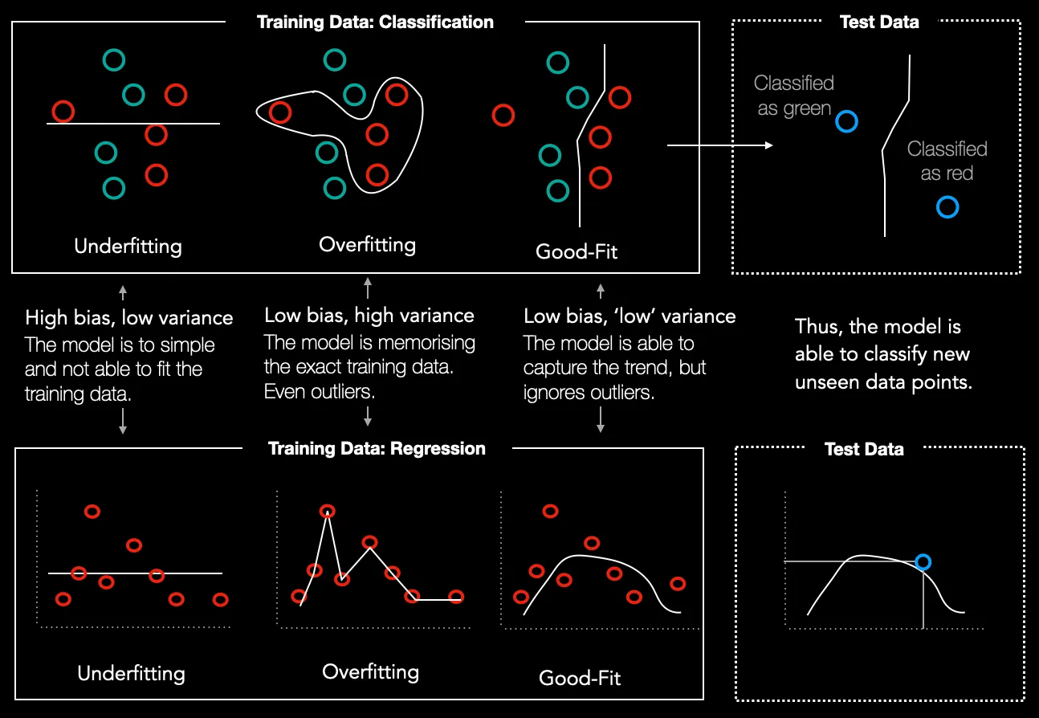
Image: Frederik vom Lehn on Medium.com

Slide 13
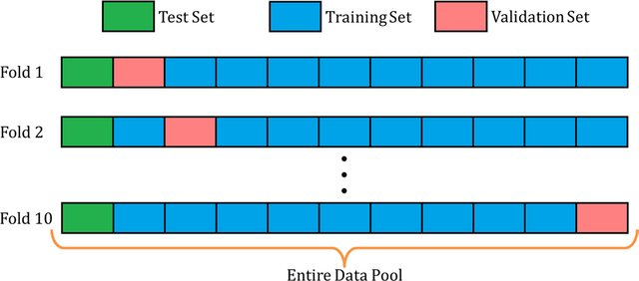
Cross-Validation
Cross-validation is a robust statistical method used to evaluate and validate the performance of machine learning models.
It is a resampling technique that ensures the model generalizes well to unseen data, mitigating the risk of overfitting or underfitting.
The method works by dividing the dataset into multiple subsets (folds) and systematically training and testing the model on different data partitions.
Image: https://stackoverflow.com/questions/62954433/how-to-predict-with-the-test-dataset-while-using-cross-validation

Slide 14

Thanks for attending!
Cuneyt.Akcora@ucf.edu

